Slide 1

Abnormal Event Detection

Slide 2
Guide: Nithya BN
Assistant Professor,
Department of Master of Computer Applications,
Ramaiah Institute of Technology, Bangalore
Team members:
Ashok Mahala: 1MS21MC010
Sharat Krishna Gouda: 1MS21MC047

Slide 3
Contents
What Is Abnormal Event ?
Problem statement
Objectives
Methods used
Results
Conclusion

Slide 4
What Is Abnormal Event ?
we can generally Say that abnormal events should be unexpected events that occur less often than familiar (normal) events.(like- Fighting in public palace, A road Accident, Someone is trying to enter into a restricted area.)

Slide 5
Introduction
This technology is designed to help detect unusual or abnormal activity in real-time, such as theft, vandalism, or other criminal activities.
The use of this technology has become increasingly important in today's world, as it provides a layer of security to ensure the safety of people and assets. In this presentation, we will delve into the technology behind Abnormal Event Detection, its benefits and limitations, and how it can be used in various applications.

Slide 6
Problem Statement
Abnormal event detection in videos involves identifying unusual or unexpected events in a video stream, such as a person breaking into a building, a vehicle accident, or a person behaving strangely in a public space.
The goal of abnormal event detection in videos is to automatically detect these events and alert security personnel or other relevant parties in real-time.

Slide 7
Overall Process (Block diagram)
Gather input data set
Clean and preprocess data
Use input data to train model
Optimize model
Feed test data to detect abnormal events

Slide 8
Methodology
The method described here is based on the principle that when an abnormal event occurs, the most recent frames of video will be significantly different than the older frames.
we train an end-to-end model that consists of a spatial feature extractor and a temporal encoder-decoder which together learns the temporal patterns of the input volume of frames.

Slide 9
Our approach consists of three main stages:
Preprocessing
Feature Learning
Anomaly Detection

Slide 10
1.Preprocessing
The task of this stage is to convert raw data to the aligned and acceptable input for the model. Each frame is extracted from the raw videos and resized to 227 X 227.
To ensure that the input images are all on the same scale, the pixel values are scaled between 0 and 1 and subtracted every frame from its global mean image for normalization.
The mean image is calculated by averaging the pixel values at each location of every frame in the training dataset.
After that, the images are converted to grayscale to reduce dimensionality.

Slide 11



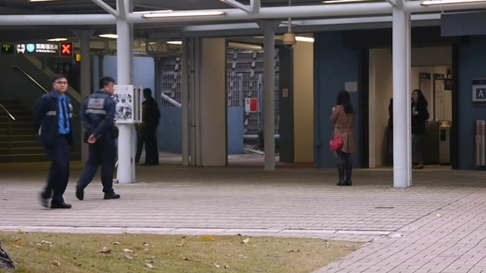
Data Pre-Processing
Input : Video
Step 1 : Convert the video to frames
Video
cv2.imread()
Frames

Slide 12
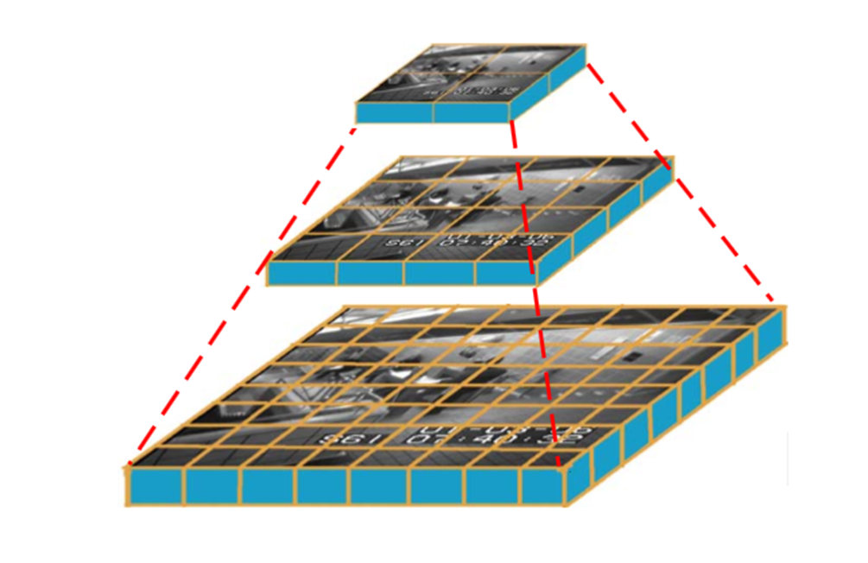
Data Pre-Processing contd..
Step 2 : For each frame, resize it to 3 scales
20x20
30x40
227x227

Slide 13
2.Feature Learning
We propose a convolutional spatiotemporal autoencoder to learn the regular patterns in the training videos.
Our proposed architecture consists of two parts :spatial autoencoder for learning spatial structures of each video frame, and temporal encoder-decoder for learning temporal patterns of the encoded spatial structures.

Slide 14
2.1 Spatio Temporal Autoencoder
A Spatio-temporal autoencoder is a type of artificial neural network that is designed to learn Spatio-temporal patterns in a sequence of data. It is typically used for analyzing and processing data that varies over both space and time, such as video or sensor data.
Autoencoders, as the name suggests, consist of two stages: encoding and decoding.
It was first used to reduce dimensionality by setting the number of encoder output units less than the input.
The model is usually trained using back-propagation in an unsupervised manner, by minimizing the reconstruction error of the decoding results from the original inputs.

Slide 15
3. Anomaly Detection
Threshold Values
Once the model is trained, we can evaluate our models performance by feeding in testing data and check whether it is capable of detecting abnormal events while keeping false alarm rate low.
We check the Loss into the frames and compare it with the threshold Value.
It is straightforward to determine whether a video frame is normal or anomalous.
The reconstruction error of each frame determines whether the frame is classified as anomalous.
The threshold determines how sensitive we wish the detection system to behave — for example, setting a low threshold makes the system become sensitive to the happenings in the scene, where more alarms would be triggered.

Slide 16
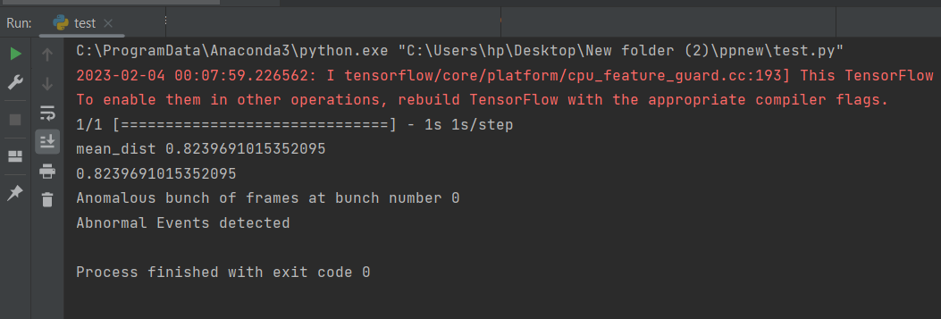
Result
We have uploaded one video for testing and that video contains something abnormal so it detects that abnormal event and gives the output as “Abnormal Event Detected”

Slide 17
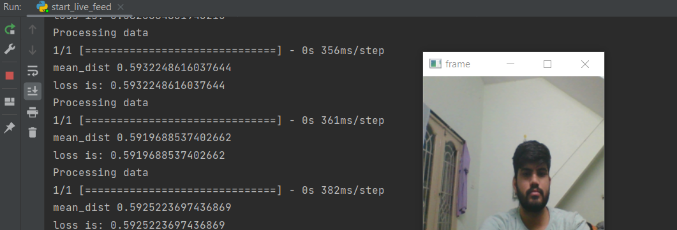
Result(cont.)
Here We started the testing on live surveillance videos .
Video is normal and there is nothing abnormal so it is just processing the data

Slide 18
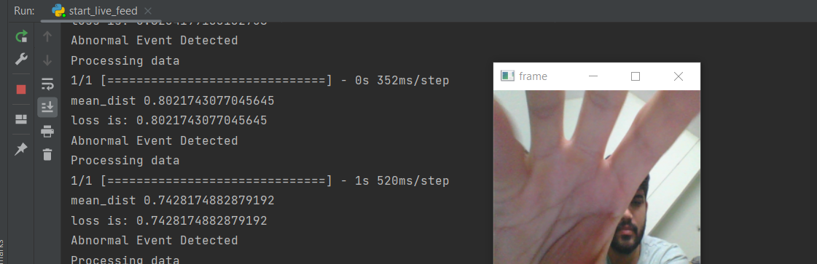
Result(cont.)
Here we tried to cover the camera so it detects it as a abnormal event and gives output as “Abnormal Event Detected” and one beep alarm is triggered.

Slide 19
Conclusion
We have successfully applied deep learning to the challenging video anomaly detection problem. We formulate anomaly detection as a spatiotemporal sequence outlier detection problem and applied a combination of spatial feature extractor.
By incorporating convolutional feature extractor in both spatial and temporal space into the encoding-decoding structure, we build an end-to-end trainable model for video anomaly detection.

Slide 20
Conclusion(cont.)
The advantage of our model is that it is semi-supervised – the only ingredient required is a long video segment containing only normal events in a fixed view.
Despite the models ability to detect abnormal events and its robustness to noise, depending on the activity complexity in the scene, it may produce more false alarms compared to other methods.

Slide 21
Thank You

